Slide 1
Python
Fun doo testers

Slide 2
Data types Set
Set is an unordered collection of data type that is iterable, mutable and has no duplicate elements.
Set in Python is equivalent to sets in mathematics.
Elements of a set can be added and deleted, elements of the set can be iterated, various standard operations (union, intersection, difference) can be performed on sets.
Syntax : set = set()

Slide 3
Agenda
Creating a Set
Adding Elements to a Set
Removing elements from the Set

Slide 4
Dictionary
Dictionary in Python is an unordered collection of data values, used to store data values like a map, which unlike other Data Types that hold only single value as an element
Dictionary holds KEY:Value pairs
Each key-value pair in a Dictionary is separated by a colon :
Keys of a Dictionary must be unique and of immutable data type such as Strings, Integers and tuples, but the key-values can be repeated and be of any type.

Slide 5
Agenda
Creating a Dictionary
Adding elements to a Dictionary
Accessing elements from a Dictionary
Removing Elements from Dictionary

Slide 6
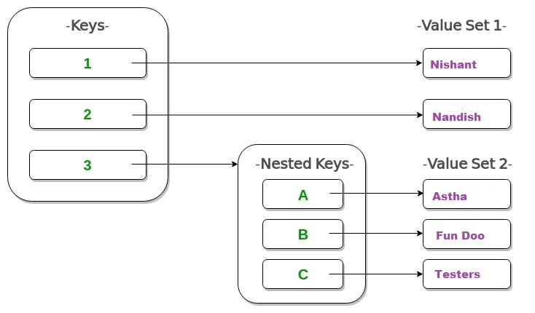

Slide 7
Arithmetic operators
Operators | Description | Syntex
+ | Addition: adds two operands | x + y
- | Subtraction: subtracts two operands | x - y
* | Multiplication: multiplies two operands | x * y
/ | Division (float): divides the first operand by the second | x / y
// | Division (floor): divides the first operand by the second | x // y
% | Modulus: returns the remainder when first operand is divided by the second | x % y

